Slide 1

Docker Vs VM
Prepared by:
Mihir Pitale
Prashant Rajbhandari

Slide 2
Virtualization
Concept of virtualization first introduced in the 1960s to allow partitioning of large mainframe hardware
An abstraction layer that decouples physical hardware from the OS to deliver greater resource utilization and flexibility
Allows multiple virtual machines with heterogeneous OS to run in isolation
Multiple VMs run side by side on the same physical machine
Each VM has its own set of resources (such as RAM, CPU, NIC) upon which an OS and application are loaded

Slide 3
Docker
Docker is considered to be an evolution from dot-cloud’s technology, based on (paas) company
Docker actualizes an abnormal state API to give lightweight compartments that run forms in isolation
Docker depends upon kernel’s functionality rather than depending on host OS system unlike in VM’s
Personal container based infrastructure can be deployed

Slide 4
Docker Installation process
Docker installation for windows home edition or 7,8,9 or lower edition, download docker quick-start terminal or docker toolbox available on hub.docker.com. Steps to install are given in below link
https://docs.docker.com/toolbox/toolbox_install_windows/
https://download.docker.com/win/stable/DockerToolbox.exe
For windows enterprise edition, or windows pro download docker for windows.
https://download.docker.com/win/edge/Docker%20for%20Windows%20Installer.exe
for mac
https://download.docker.com/mac/edge/Docker.dmg
play-with-docker.com allows you to create running instance of multiple docker for 4 hours if you aren’t interested in installing docker on your PC

Slide 5
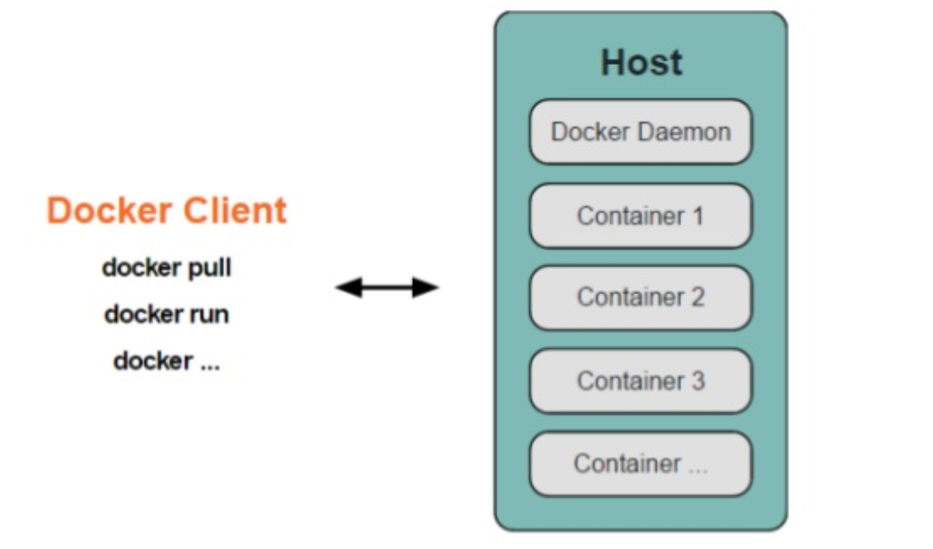
Docker Architecture
Docker is based on
client server architecture
Daemon acts as a server
Daemon performs build, run and
distribute operations of containers
Client and Daemon can run on the
same host or different hosts
Kitematic is an example of client which can run as CLI client and has GUI

Slide 6
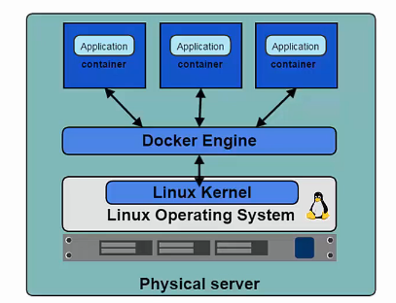
Docker engine
Is the program that allows container to build, ship and run
Resides at the core of docker platform
Also referred as docker daemon
Uses linux kernel to create and manage containers
Docker engine uses linux kernel namespace and control groups to manage containers
Namespace allows us to use isolated workspace
Docker engine uses
PID namespace for process isolation
NET namespace for initiating network
MNT namespace for managing mount point
All namespace used by Docker engine creates isolated workspace called container.
Notes:
Namespaces are a feature of the Linux kernel that partitions kernel resources such that one set of processes sees one set of resources while another set of processes sees a different set of resources. The feature works by having the same name space for these resources in the various sets of processes, but those names referring to distinct resources.

Slide 7
Containers and Images
When docker runs a container, it looks for the image locally in image cache, then looks in Dockerhub image repository
Gets the image, gives virtual IP on private network inside docker engine, opens port 80 by default
Containers can change image file on forming new container called COW, unlike in VM’s where orchestration is not managed
Container is layer on top of images

Slide 8
Comparison
Image
Container
Is a binary that includes all the requirements for a running a single container along with metadata describing its need and capabilities
An application we want to run
Are read only template
Is an instance of that image running as a process
Isolated application platform build from images
We can have many containers running of the same image
We can add a layer of services on top of base image using containers and create a new custom image

Slide 9
Docker-Compose
Now in order to run multiple containers, docker introduced docker-compose
The configuration files of all containers are combined and saved in easy read file
Yml file is the extension used for docker compose which contains applications, container, networks, volumes code
It basically automates a shell script
Docker file and Docker-Compose.yml file needs to be prepared for combination of project
Docker-compose up, docker-compose down are commands for starting and stopping compose file

Slide 10
Docker-Compose proxy
Here is a demonstration of docker-compose method for creating multiple proxy and web backend server
Proxy is httpd and nginx is running in backend
Docker-compose talk to docker api in background on behalf of docker CLI
Config file is created for local drupal CMS website as follows

Slide 11
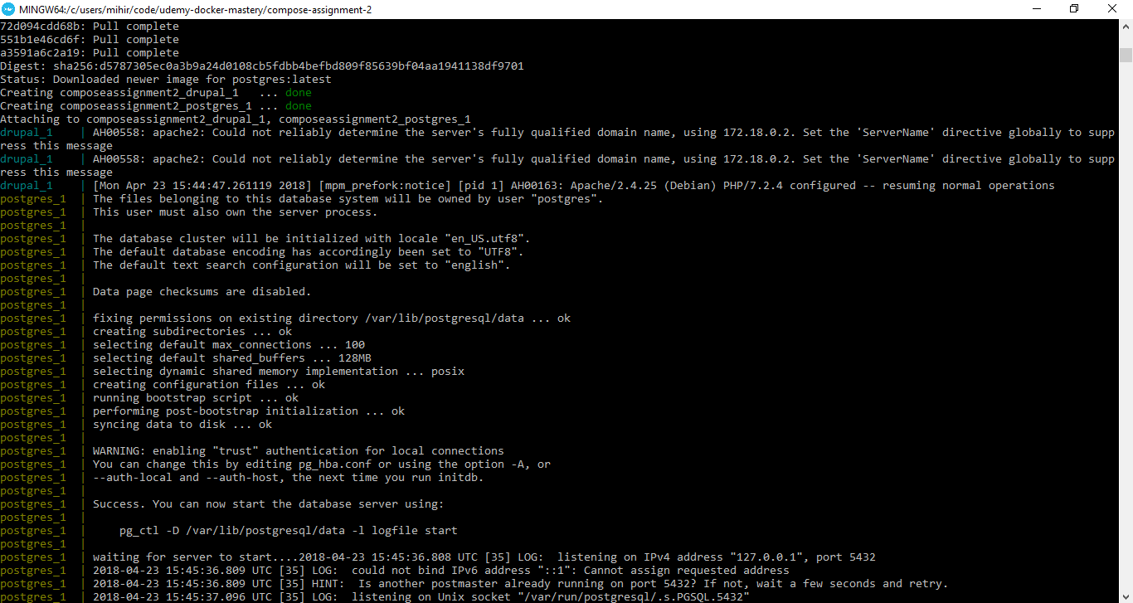
Docker-compose proxy

Slide 12
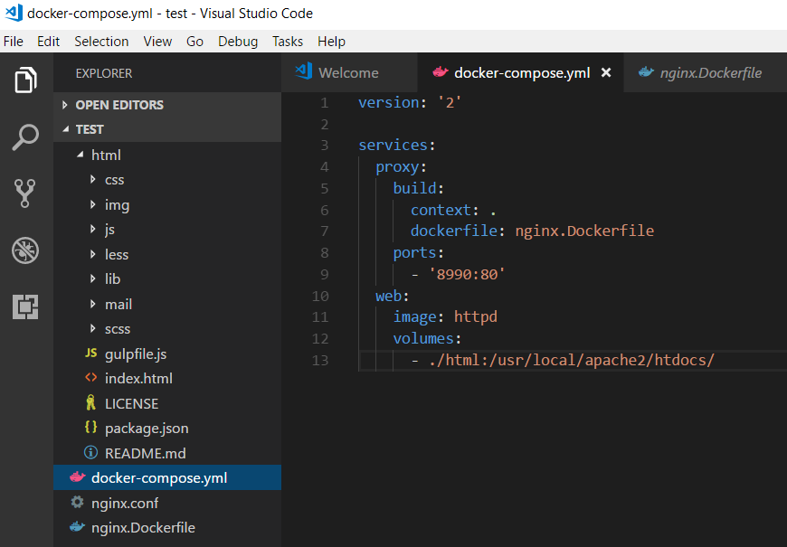
YML file

Slide 13
Docker-swarm
Swarm was made to automate container lifecycle, control track of where container gets started
It is mainly used to create cross-node virtual networks and to keep stack and secrets
Swarm checks that only trusted servers run the containers
Swarm mode is built in clustering solution
It consists of manager node and worker node
It has service → multiple tasks→ containers in table

Slide 14
Docker-swarm
Swarm doesn’t have a backend database configuration management unlike config DB in services running VM’s
Swarm does three things-
Root certificate is created
join-token is created from manager side in order for worker to become manager
Certificate for manager
Leader← Manager← Worker
It creates multiple docker machine from same CLI nodes

Slide 15
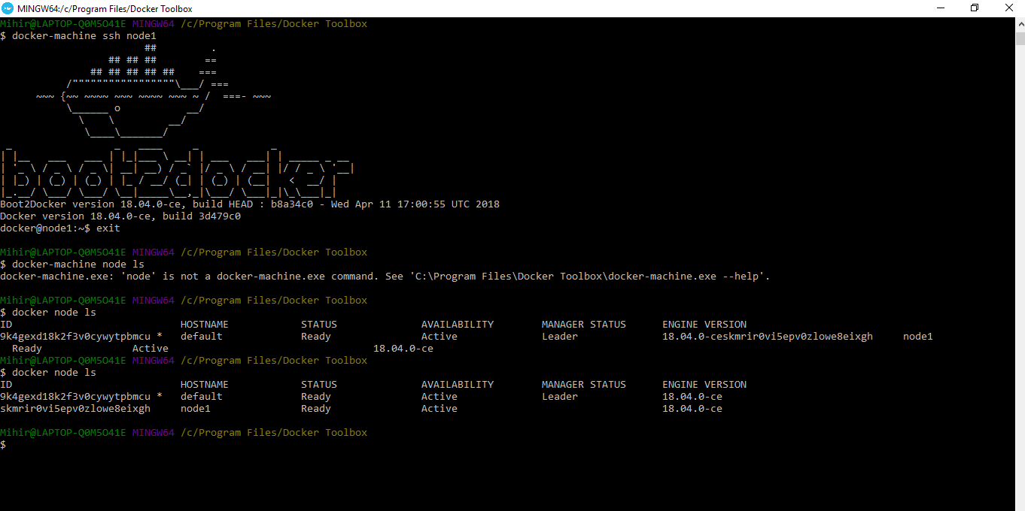
Swarm 3-node cluster

Slide 16
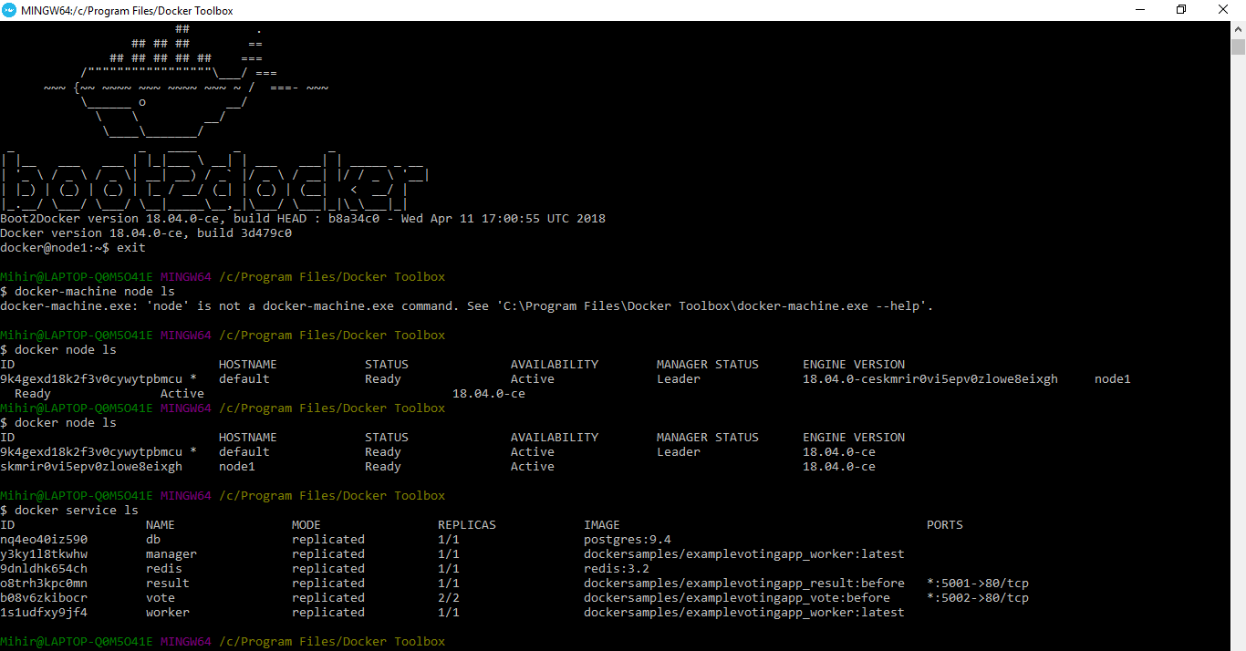
Docker-swarm voting app

Slide 17
Docker-swarm
The Important benefit of docker-swarm is if one node fails, the docker pulls other node to run the same ip address and application.
Used combination of nodes and database as an example of using multi-service swarm for global use
The database is taken from docker-hub and modification are made in python script
The app is a voting app which uses the ports 5001 and 5002 configured

Slide 18
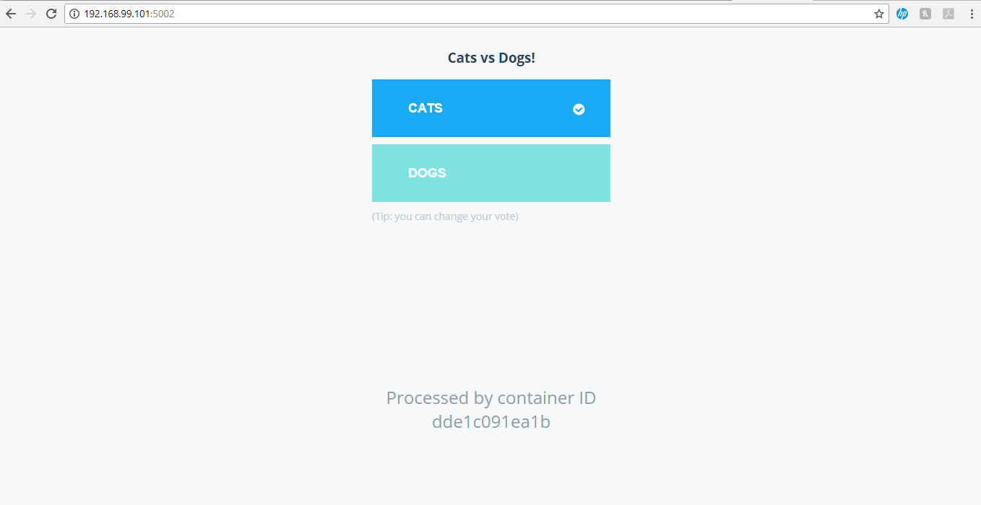
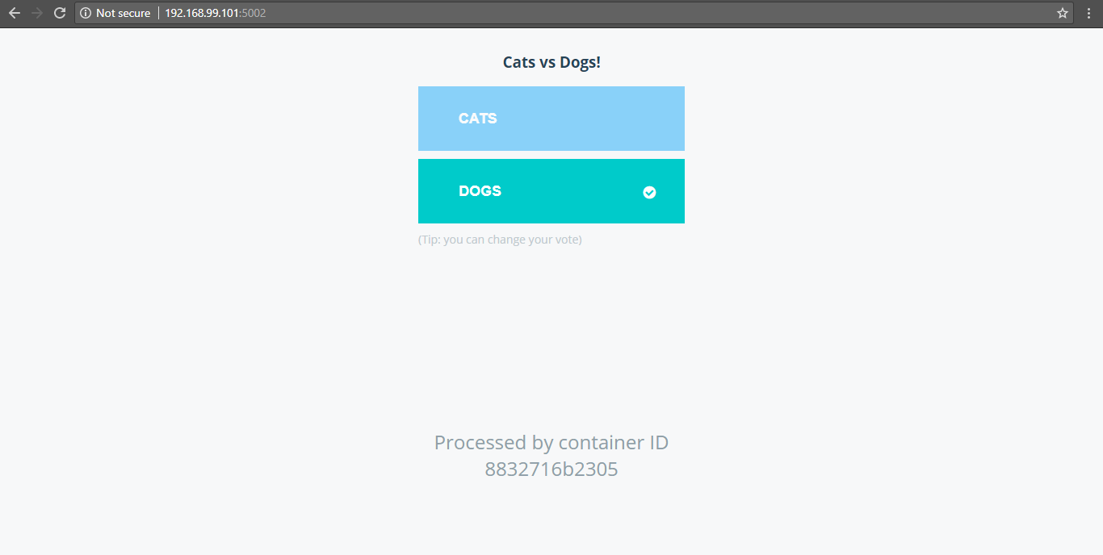
Docker-swarm

Slide 19
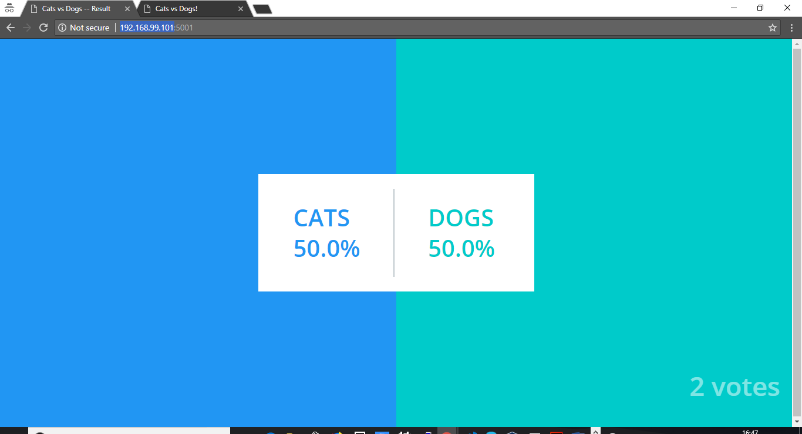
Docker-swarm

Slide 20
Comparison
Container
VM
Requires an underlying OS that provides basic services to all of the containerized application using virtual memory support for isolation
Have lower overhead
Targets environments where thousands of containers are used
Provide service isolation between containers
Are lightweight
Does not require guest OS to run any application; can directly deploy application inside container
Less CPU, RAM, storage
Free of cost
Hypervisor runs VMs that have their own OS using hardware VM support
Have larger overhead
Provide entire OS isolation
Requires guest OS to run application
More CPU, RAM, storage compared to Container
Requires specific set of hardware requirement like min RAM, CPU, storage
Expensive in terms of purchasing license for guest OS and HyperV license

Slide 21
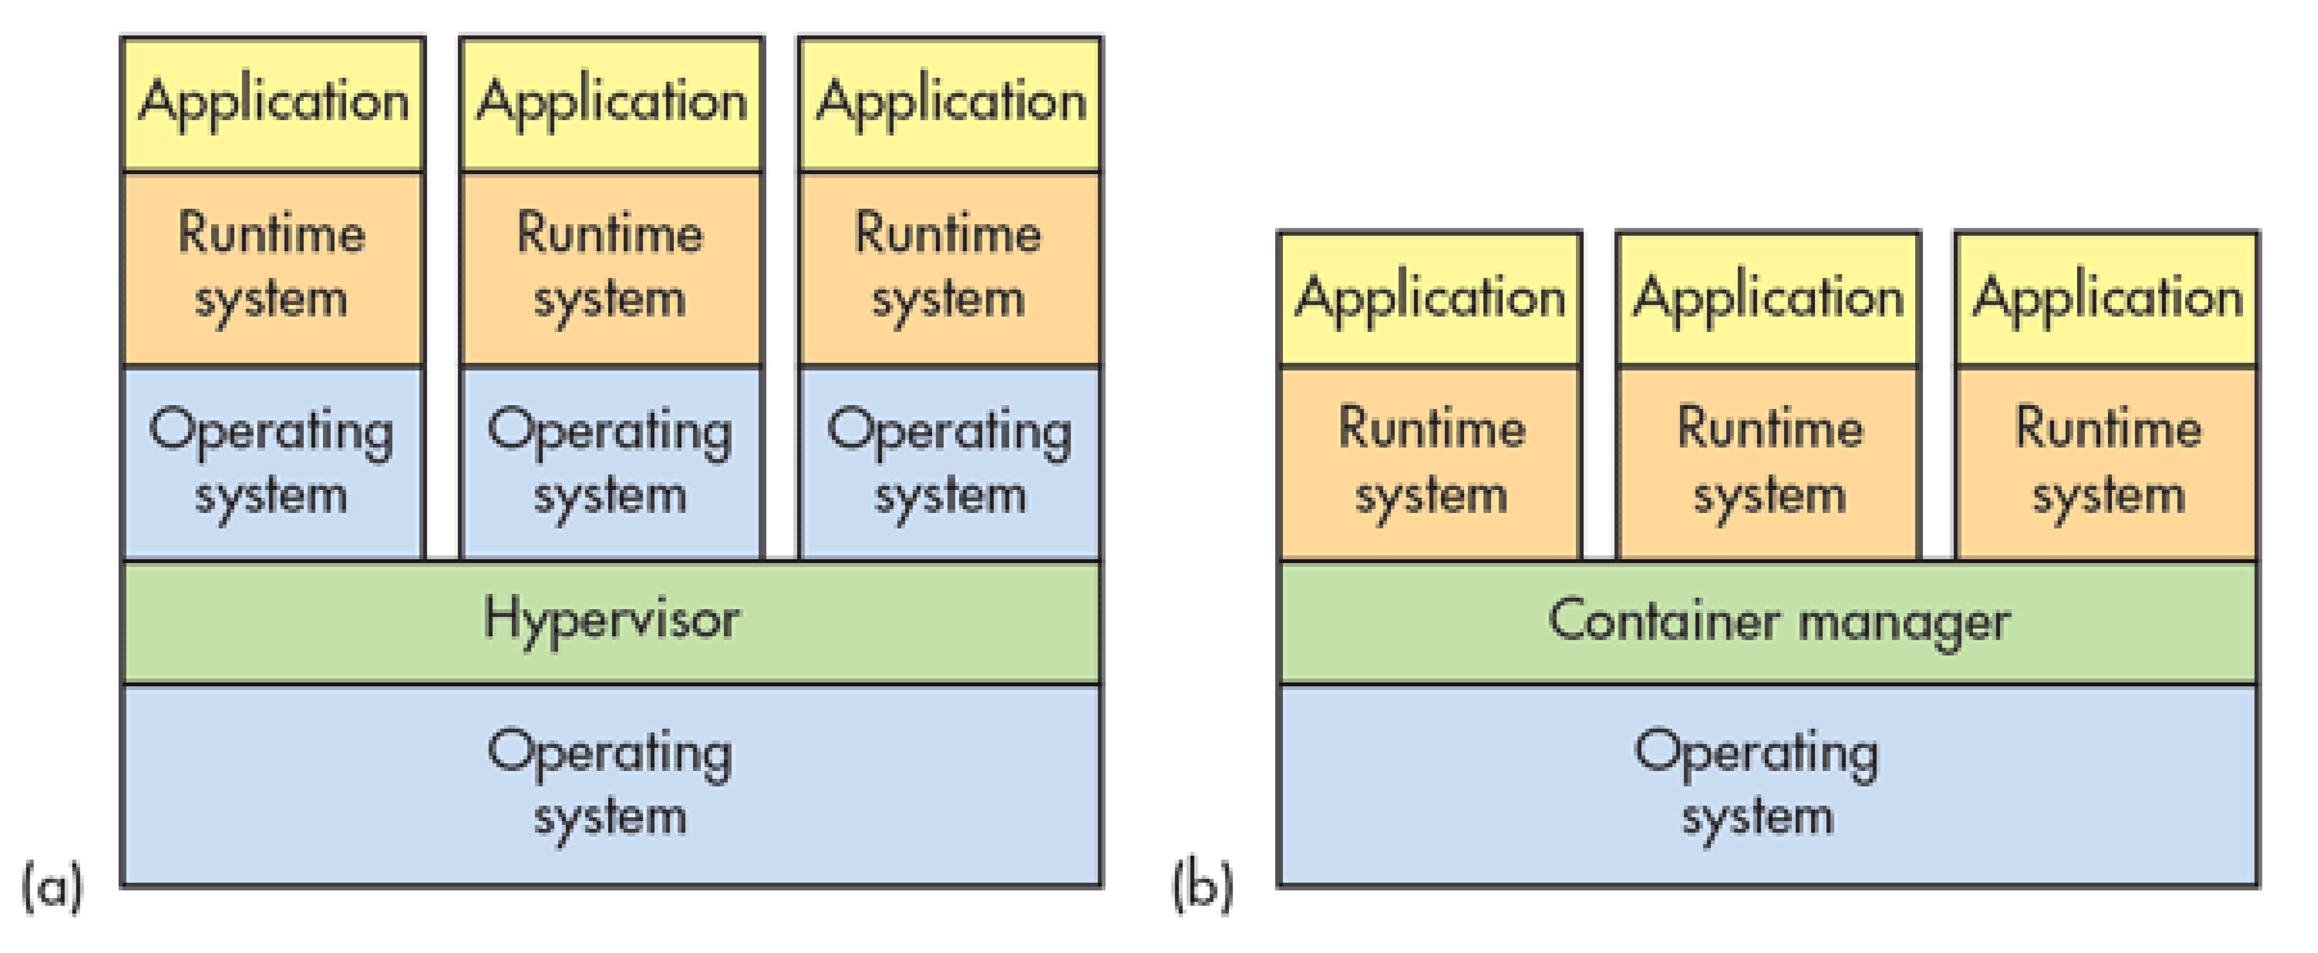

Slide 22
Performance comparison
 | Container | VM
Operating system | Full individual guest OS | Uses host OS
CPU | Less than 1 core | More than 1 core
Memory (RAM) | Less than 512 MB | More than 1 GB
Boot up | Order of milliseconds | Order of seconds
Failure | No Checkpoint | Checkpoint can be created
Security | Less secure as container use Host OS resources | Secured as VM’s guest OS is totally isolated from Host OS
Enterprise | Ongoing | Yes

Slide 23
Docker webinar and handouts
https://drive.google.com/open?id=1_E9L1q3Yrbcd6EZfYvWjrwdqDmZEpVjU – e-book for understanding docker
https://drive.google.com/open?id=1i3cTKyHNaAVE2-40Jz34HqCmK8blqWfl
https://drive.google.com/open?id=1flwzqMKhoGFROIp86YoQ0DkvWjSIMhBf
https://drive.google.com/open?id=1ZFRrGWcm6VEjX7TENuWjDi4lzn2vGF0H
https://drive.google.com/open?id=1Pkplsqv4R77ulnCU5CvyuLSr_-fq7AYU
https://drive.google.com/open?id=1g9pyd83GpTLoS7EBNH9IjtratWJclKId

Slide 24
Thank You!!!

